Slide 1
Revolutionary Artifacts

Slide 2
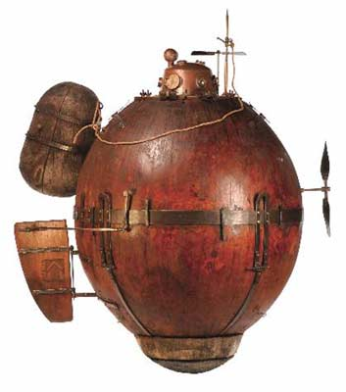
Artifact 1—American Revolution

Slide 3
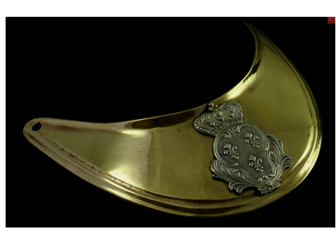
Artifact 2—American Revolution

Slide 4
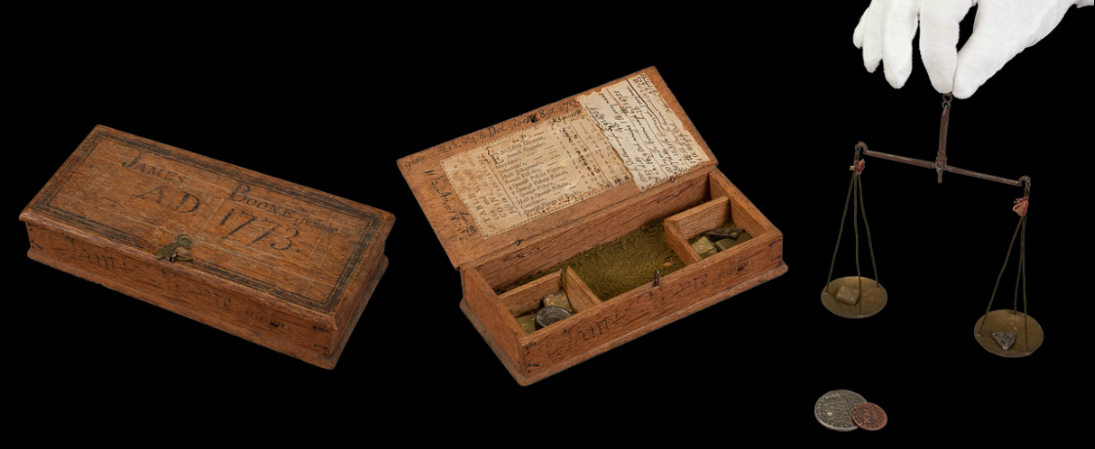
Artifact 3—American Revolution

Slide 5
Artifact 4—American Revolution

Slide 6
Artifact 5—American Revolution

Slide 7
Artifact 6—American Revolution

Slide 8
Artifact 7—American Revolution

Slide 9
Artifact 8—American Revolution

Slide 10
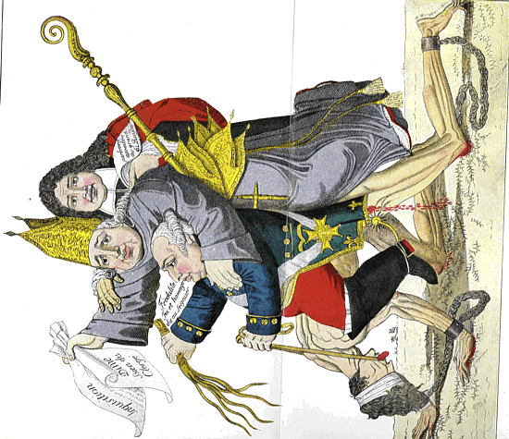
Artifact 9

Slide 11
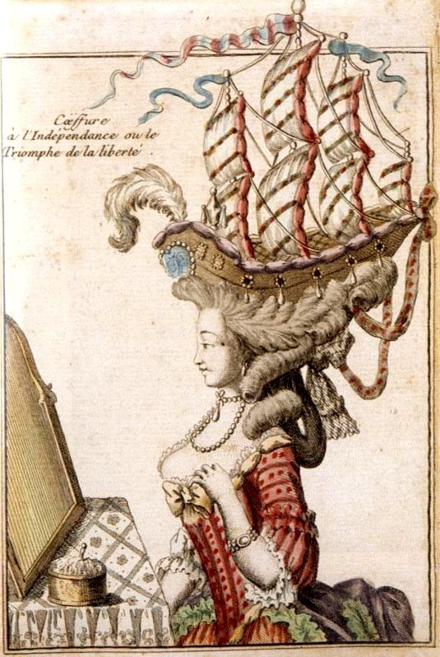
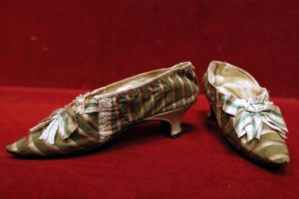
Artifact 10—French Revolution

Slide 12
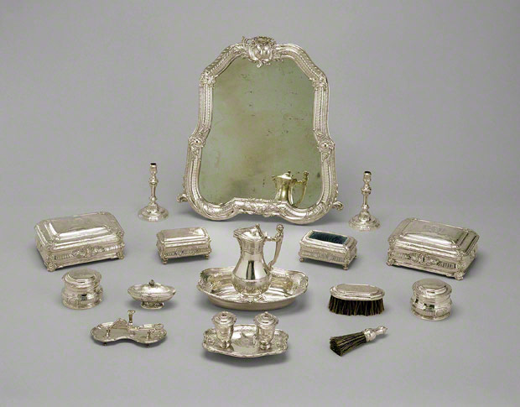
Artifact 11—French Revolution

Slide 13
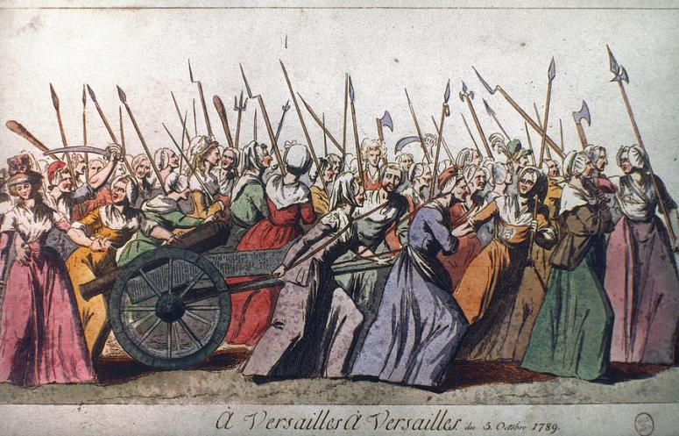
Artifact 12—French Revolution

Slide 14
Artifact 13—French Revolution

Slide 15
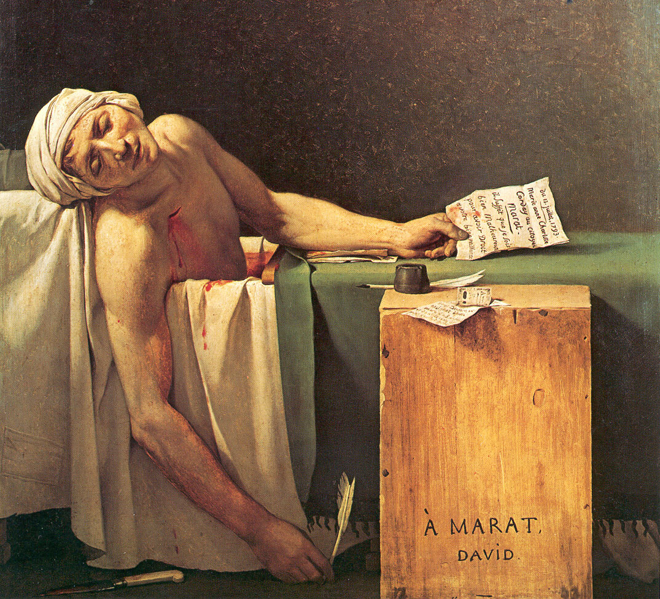
Artifact 14—French Revolution

Slide 16
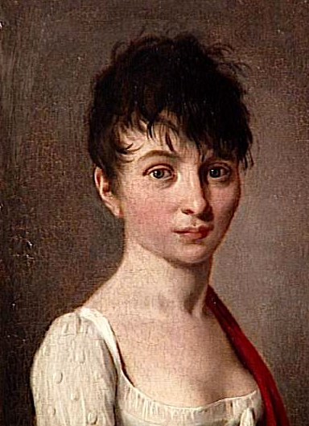
Artifact 15—French Revolution

Slide 17
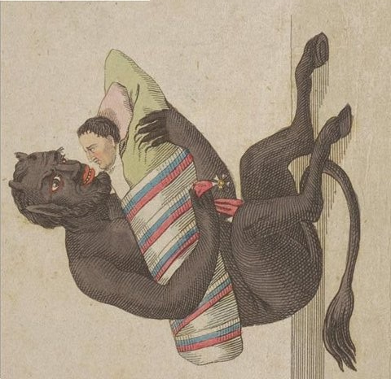
Artifact 16—French Revolution

